Slide 1

Crypto Wallets
SANKALP GHODESHWAR -02
MANASWI PATIL -05
SAMIKSHA PAWAR -16
ANAND SAHANI -28
GUIDE - MRS. BHAVIKA JOSHI

Slide 2
What is a Crypto Wallet?
Digital Storage
Transaction Management
Not Physical
A crypto wallet stores your private keys. These keys allow access to your cryptocurrencies.
Wallets facilitate sending and receiving digital assets. They verify transactions using blockchain.
Unlike traditional wallets, crypto wallets don't hold currency. They hold digital keys.

Slide 3

The Problem with Traditional Wallets
1
Centralized Control
2
Risk of Theft
3
Transaction Fees
Traditional wallets are controlled by financial institutions. This can lead to censorship.
Physical wallets can be easily stolen. Digital accounts are vulnerable to hacking.
Traditional wallets often incur high transaction fees. This reduces the value of transactions.

Slide 4
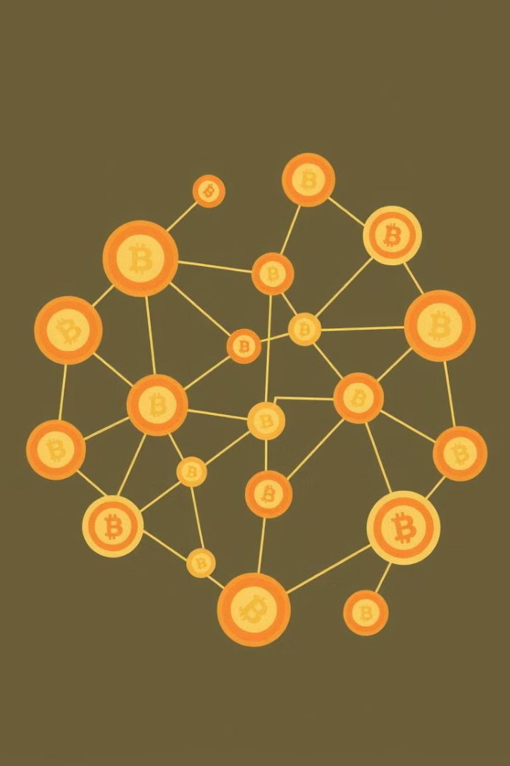



Blockchain Technology: The Foundation of Crypto Wallets
Decentralization
Security
Transparency
Blockchain is a distributed ledger system. It ensures no single point of failure or control.
Cryptography secures transactions and wallet access. This protects against unauthorized access.
All transactions are recorded on a public ledger. This provides transparency and auditability.

Slide 5
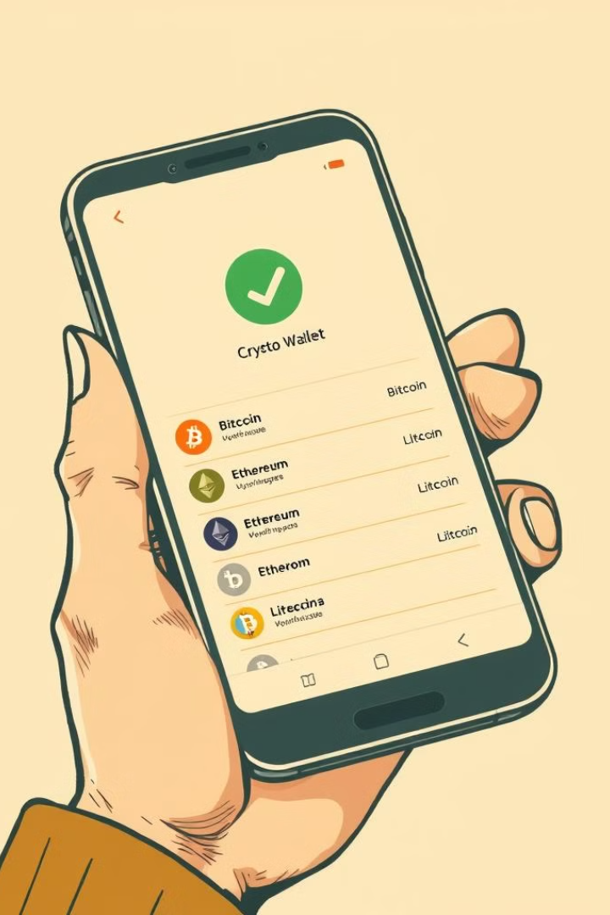



Key Features of a Secure Crypto Wallet
Private Key Encryption
Protecting private keys is crucial. Encryption adds an extra layer of security.
Two-Factor Authentication
2FA requires a second verification method. It prevents unauthorized access even with compromised passwords.
Multi-Sig Support
Multi-signature wallets require multiple approvals. This protects against single points of failure.

Slide 6



Emerging Trends in Crypto Wallet Technology
Decentralized Finance (DeFi) Integration
2
Direct access to DeFi platforms within wallets. Allows for staking, lending, and borrowing.
Multi-Chain Support
1
Wallets that support multiple blockchains. This enables users to manage diverse assets.
Improved User Experience
User-friendly interfaces and simplified processes. This enhances accessibility for new users.
3

Slide 7



The Future of Crypto Wallets: Innovations and Adoption
1
Widespread Integration
2
Enhanced Security
3
Improved Accessibility
Crypto wallets are evolving rapidly. Expect to see greater adoption and more advanced features. Innovations will drive broader acceptance.

Slide 8
THANK YOU !

